Slide 1







ACASIA PARTNERS & CLIENTS
SHAREHOLDERS

Slide 2











ACASIA PARTNERS & CLIENTS
STRATEGIC PARTNERS

Slide 3









ACASIA PARTNERS & CLIENTS
STRATEGIC PARTNERS

Slide 4









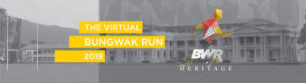
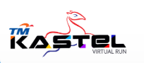




SOFEA RUN PARTNERS AND CLIENTS
EVENT ORGANIZER
UNIVERSITY SCHOOL ALUMNI
CORPORATE
Man United Fan Run 2019
Malaysia
Malaysia Women Marathon 2019
Malaysia
Hari Sukan Negara 2019
Malaysia
Twincity Marathon 2019
Malaysia
CAT10K Championship 2019
Thailand
Charity Walk and Run 2020
Brunei
Uni Teknikal Malaysia Melaka
Universiti Teknologi Mara –
Kampus Bandaraya
Tunku Kurshiah College
Malaysia
Malay College Kuala Kangsar
Malaysia
Rotary Club of Dusit
Thailand
TM Global HR
TM NOC
TM ONE HR
Kastel Committee

